Slide 1
Research Platform for Custom Memory Cube
Dr. Herman Lam
Assoc. Professor of ECE
University of Florida
Yu Zou
Vinayak Deshpande
JeshalrajThakaria (volunteer)

Slide 2
Outline
Brief review & overview
Performance measurements on Merlin board
Mapping notional CMC to Merlin board
Validation of performance measurements on Merlin board
Validation using HMC simulator
Experiment 1
Experiment 2
Application exploration using HT
Bloom filter examples
Going forward
HT Programming Basics
* DRE: Data rearrangement/reordering engine ** CMC Computational Memory Cube

Slide 3
Outline
Brief review & overview
Performance measurements on Merlin board
Mapping notional CMC to Merlin board
Validation of performance measurements on Merlin board
Validation using HMC simulator
Experiment 1
Experiment 2
Application exploration using HT
Bloom filter examples
Going forward
HT Programming Basics
* DRE: Data rearrangement/reordering engine ** CMC Computational Memory Cube

Slide 4
Performance Measurement on Merlin Board
CMC platform on Merlin board
*
Instrumented Merlin infrastructure with hardware performance monitors
A’, B’, C’, D’, M1, M2, M3, M4, M5, and E’
Progress: Able to measure all listed parameters except:
M4, M5: Exploring with help from Convey
E’: Exploring with help with Micron under NDA
VB*: View Buffer

Slide 5
Mapping Notional CMC onto Merlin Board
Merlin board
Case study: model of a notional CMC
Simplifying assumption:
For this model, this part of CMC is assumed to have an HMC architecture
Observation:
“Pipelining” effect of overlapping memory access

Slide 6
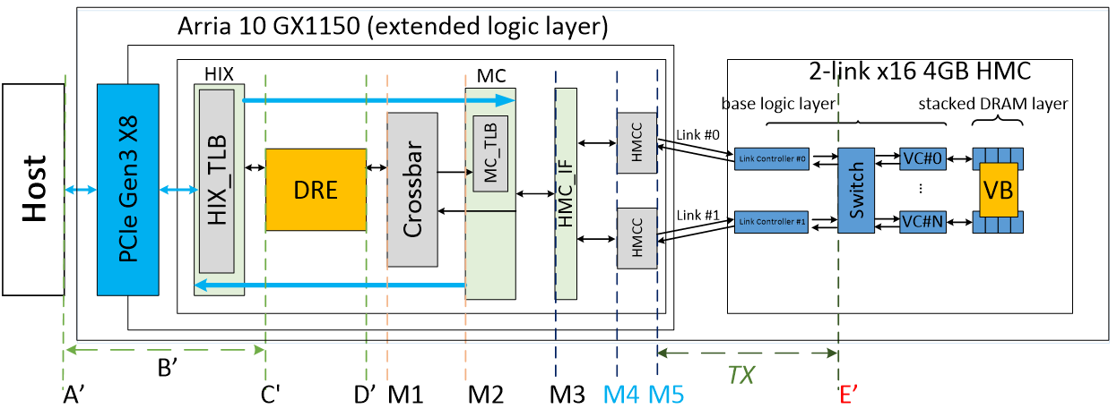
Observation: Overlapping Memory Access
For overlapping read/write ops:
Measurements at M1, M2, M3, (M4, M5, E’) have no significant difference

Slide 7
Overlapping Memory Access: DRE ops
Observation: M1, M2, M3, (M4, M5, E’) again have no significant difference
For overlapping memory access, discrepancy between M1, M2, M3, (M4, M5, E’) is hidden by “pipeline effect”
Thus, for overlapping memory access, we will use measurements at M3 in this presentation.

Slide 8
Outline
Brief review & overview
Performance measurements on Merlin board
Mapping notional CMC to Merlin board
Validation of performance measurements on Merlin board
Validation using HMC simulator
Experiment 1 – blocking memory access
Experiment 2 – pipelined memory access
Application exploration using HT
Bloom filter examples
Going forward
HT Programming Basics
* DRE: Data rearrangement/reordering engine ** CMC Computational Memory Cube

Slide 9
Validation Experiments
Validation of performance measurement on Merlin board
Approach
compare Merlin board measurement vs. Micron HMC SystemC simulator results
vs.
Experiments:
Blocking memory access pattern
Comparison of average latency of single memory access
Comparison of total overlapping latency (total latency = # mem. req. * avg. latency)
Pipelined memory access pattern
Comparison of average latency of single memory access
Comparison of total overlapping latency

Slide 10
Exp. 1a: Average Latency, Blocking
Measurement on Merlin board
3. Calculate average (100000 accesses) latency & compare with avg. latency reported in SystemC Simulator
2. Measure latency of each single memory access at M3
Simulation on HMC Simulator
1. Input blocking memory requests

Slide 11
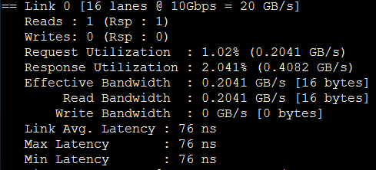
Exp. 1a: Average Latency, Blocking
Results from SystemC Simulator
Avg. Latency measured on Merlin board

Slide 12
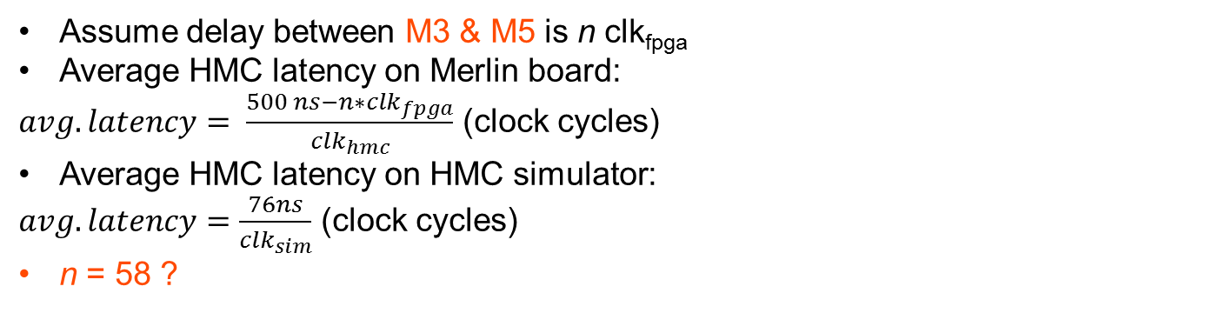
Exp. 1a: Avg. Latency, Blocking
Merlin Board
HMC Simulator
Clk freq.
freq_{fpga} = 167MHz (6ns/clk)
freq_{hmc} = 333MHz (3ns/clk)
freq_{sim} = 625MHz (1.6ns/clk)
Assume delay between M3 & M5 is n clk_{fpga}
Average HMC latency on Merlin board:
$avg. latency= \frac{500 ns−n∗{clk}_{fpga}}{{clk}_{hmc}}$ (clock cycles)
Average HMC latency on HMC simulator:
$avg. latency=\frac{76ns}{{clk}_{sim}}$ (clock cycles)
n = 58 ?

Slide 13
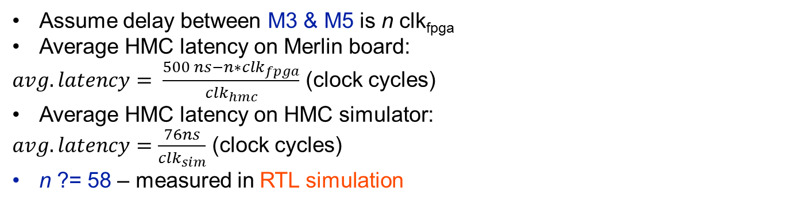
Exp. 1a: Avg. Latency, Blocking
Merlin Board
HMC Simulator
Clk freq.
freq_{fpga} = 167MHz (6ns/clk)
freq_{hmc} = 333MHz (3ns/clk)
freq_{sim} = 625MHz (1.6ns/clk)
Progress:
Setting up RTL simulation of Merlin infrastructure code
Working on getting Synopsys VCS license
To contact Altera about measurement information of HMCC
Assume delay between M3 & M5 is n clk_{fpga}
Average HMC latency on Merlin board:
$avg. latency= \frac{500 ns−n∗{clk}_{fpga}}{{clk}_{hmc}}$ (clock cycles)
Average HMC latency on HMC simulator:
$avg. latency=\frac{76ns}{{clk}_{sim}}$ (clock cycles)
n ?= 58 – measured in RTL simulation

Slide 14
Exp. 1a: Avg. Latency, Blocking
Merlin Board
HMC Simulator
Clk freq.
freq_{fpga} = 167MHz (6ns/clk)
freq_{hmc} = 333MHz (3ns/clk)
freq_{sim} = 625MHz (1.6ns/clk)
Progress:
Setting up RTL simulation of Merlin infrastructure code
Working on getting Synopsys VCS license
To contact Altera about measurement information of HMCC
Assume delay between M3 & M5 is n clk_{fpga}
Average HMC latency on Merlin board:
$avg. latency= \frac{500 ns−n∗{clk}_{fpga}}{{clk}_{hmc}}$ (clock cycles)
Average HMC latency on HMC simulator:
$avg. latency=\frac{76ns}{{clk}_{sim}}$ (clock cycles)
n ?= 58 – measured in RTL simulation

Slide 15
Exp. 2a: Avg. Latency, Pipelined
Measurement on Merlin board
4. Calculate average (1000 accesses) latency & compare with avg. latency reported in SystemC Simulator
3. Measure latency of each single memory access at M3
2. Input collected memory trace to simulator
Simulation on HMC Simulator
1. Collect memory trace from hardware

Slide 16
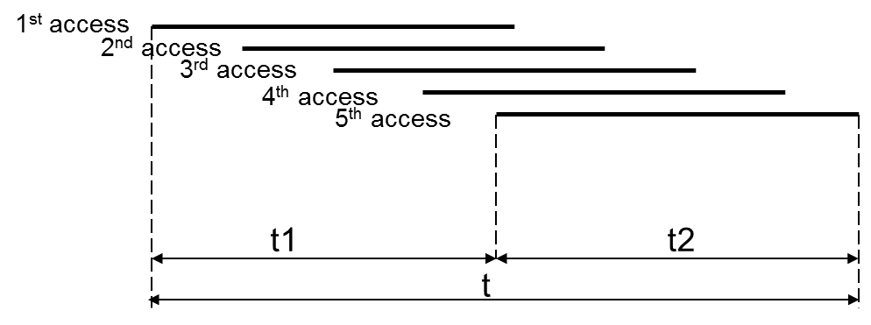
Experiment 2b Description
Recall
In overlapping access
M1 = M2 = M3 = (M4 = M5 = E’)
For HMC
M5 = C (from simulator
E = E’ (from simulator
Expect: M3 = M5 (= E’) = C = E (from HMC simulator)
Measure T (total latency) at M3
D
L
T

Slide 17
Exp. 2b: Total Latency, Pipelined
Measurement on Merlin board
Expect: M3= M5 (= E’) = C = E (from HMC simulator)
2. Input collected memory trace to simulator
Simulation on HMC Simulator
1. Collect memory trace from hardware
* DRE: Data rearrangement/reordering engine ** CMC Computational Memory Cube

Slide 18
Exp. 2 Results
Measured Avg. Latency
Measured Total Latency
Simulation Avg. Latency
Simulation Total Latency
Bottleneck

Slide 19
Outline
Brief review & overview
Performance measurements on Merlin board
Mapping notional CMC to Merlin board
Validation of performance measurements on Merlin board
Validation using HMC simulator
Experiment 1
Experiment 2
Application exploration using HT
Bloom filter examples
Going forward
HT Programming Basics
* DRE: Data rearrangement/reordering engine ** CMC Computational Memory Cube

Slide 20
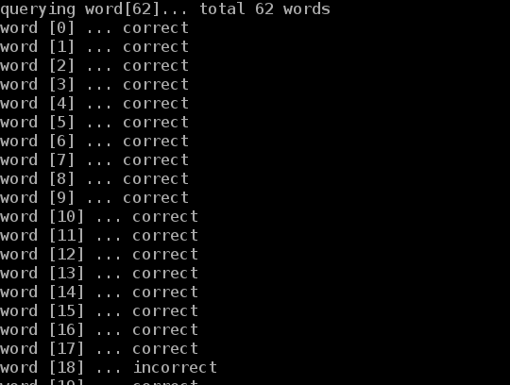
Bloom Filter HT Demos
Spell checker
Input
A dictionary
Words to check
Function
A bloom filter was pre-set using the dictionary
A new word was compared against bloom filter to check existence in the dictionary
Output
A wrong spelling is reported if the new word doesn’t exist in bloom filter
HT utilization
1 HT unit

Slide 21
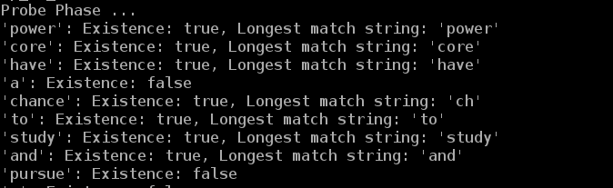
Bloom Filter HT Demos
Content-based deep packet inspection (longest string match)
Input
A group of different-length sensitive words
Packet to inspect
Function
All same-length sensitive words are used to set the same bloom filter
Multiple bloom filters are pre-set
A new packet is compared against bloom filters to check existence of sensitive words
Output
Report the packet contains sensitive information, if matched
HT utilization
16 HT units

Slide 22
Going Forward
F1
Platform development
Complete validation of CMC platform
Complete development & instrumentation of CMC platform
Develop library for customization of notional CMC architecture under study
Create user-friendly CMC API
Explore CMC apps using HT
Case studies to explore
Notional CMC architectures
CMC apps, including:
Data Reordering/Rearrangement Engine, sorting algorithms, bloom filter
Lessons learned, including:
Characteristics of CMC-amenable apps
How to re-factor algorithms to become CMC-amenable

Slide 23
HT Programming
Dr. Herman Lam
Assoc. Professor of ECE
University of Florida
Yu Zou
Graduate Student (Research Assistant)

Slide 24
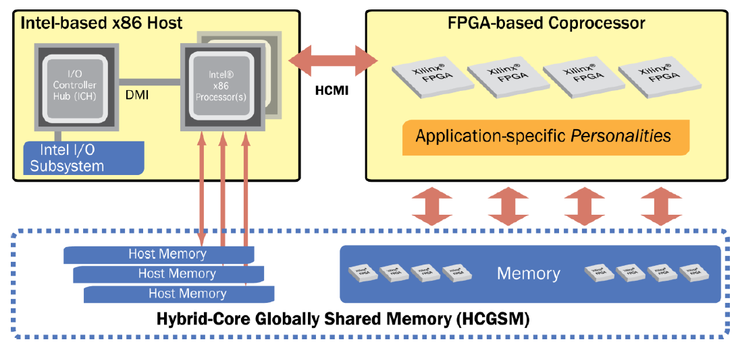
Convey HT Background
Convey computers
Startup since 2006, based @ Texas
Hybrid-core computing platforms
Joined CHREC in 2013
Via F3, focusing on bioinformatics app acceleration
Convey system philosophy – hybrid-core computing
Features | Convey
Programming | C/Cpp/ASM + HT + (HDL)
Data Addressing | explict, consistent
Host Connection | PCIe 2.0/3.0
HT : Hybrid threading - Convey’s HLS-like programming tool

Slide 25
Overview of HT Programming Model
Application “call-graph” structure

Slide 26
HT Infrastructure
Host-coproc. strucutre
Message/Data interfaces
HT unit
Replication mechanism
HT module
Essential functional blocks
Memory hierarchy
Can be replicated
Messaging interfaces among modules
Instructions
User-defined behaviors of modules

Slide 27
HT Toolset
Supported variable type
Private variable
Shared variable
Global variable
Supported data type
uint64_t, uint32_t
ht_uint1_t, ht_uint2_t, …, ht_uint64_t
ht_int1_t, ht_int2_t, … , ht_int64_t

Slide 28
User Programmable Parts
Host source files
Define program behaviors on the host, including data transmission, control flow, user interface, etc.
Hardware description files (.htd)
Declare modules, variables, memory interfaces, etc.
Module instruction files (.cpp)
Define behaviors of modules, including memory I/O, messaging interface, computation, etc.

Slide 29
High-level Design Flow

Slide 30
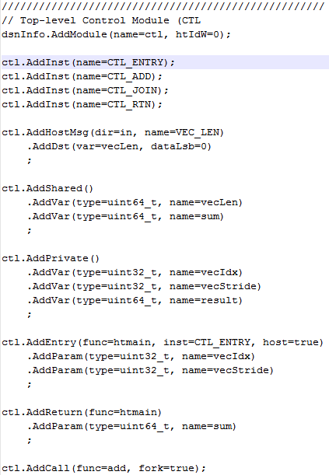
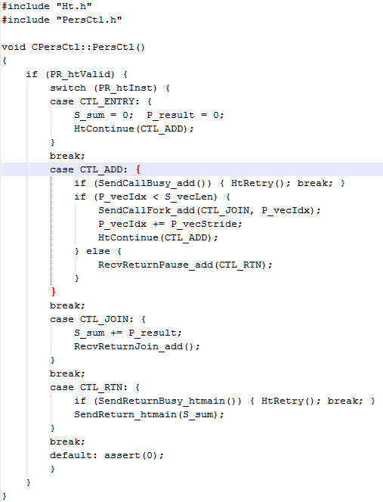
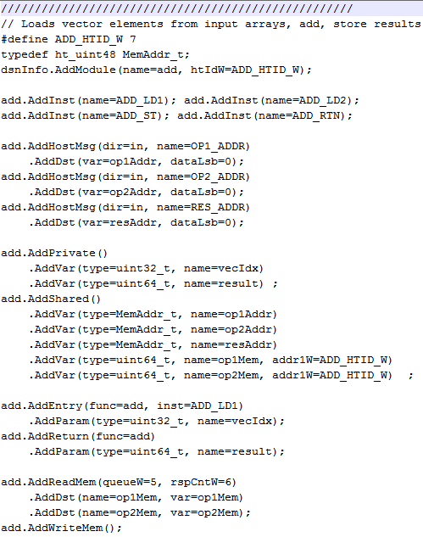
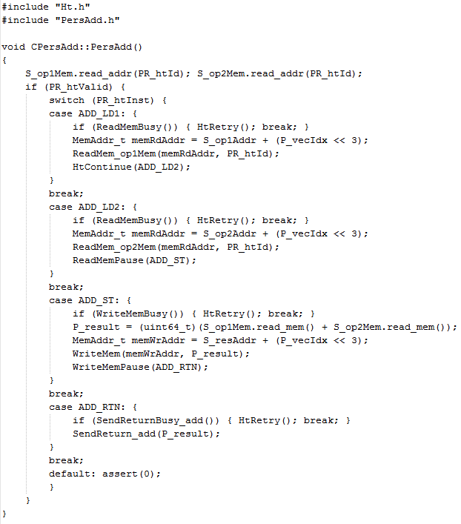
HT Code Example
Personality
HT Example: Vector-add personality
B
A
HT
Vadd Pers.
Add.htd
PersAdd_src.cpp
Ctl.htd
PersCtl_src.cpp
C
Thread control
Control (CTL)
1 thread
Memory Operations
Fn1
128 threads
Call to ADD module
ADD
Fn2
Fn3
Host message
Fn4
Variable declaration
Addition
Module I/O definition
Memory interface
Interface to other modules
HT tool flow
Personality with HT

Slide 31
HT Demo – Spell Checker
Algorithm: Bloom filter
Function: to train a filter, which can report whether an item was seen before or not
Use case: spell checker
Use a dictionary to train a filter
Use the trained filter to check a input word
If it was seen before (i.e. it exists in the dictionary), it is reported as a correct spelling
If not (i.e. it doesn’t exist in the dictionary), it is reported as a wrong spelling

